Slide 1
Culinary Agent
Arin Agarwal
aa5844@columbia.edu
2026
Spring

Slide 2
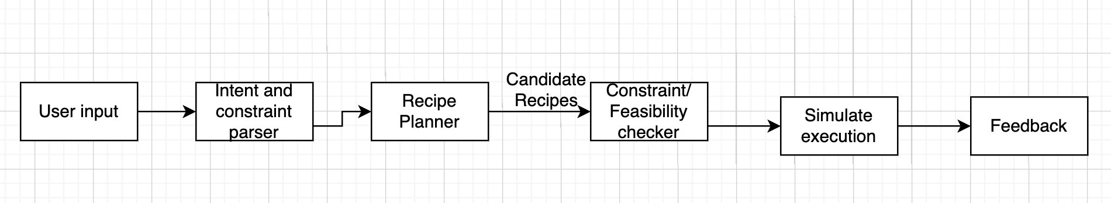
GOALS
Overall Objective
Questions to Answer
A Culinary Intelligence Agent that plans, adapts, and learns recipes under constraints, uncertainty, and human feedback.
Want to be able to input available ingredients, time, and nutrition constraints and get a viable recipe that hits all of these constraints, while optimizing flavor.
How can an agent plan multi step actions where outcomes are not completely observable
How can preferences such as taste, ingredients, culture, and nutrition be modeled and optimized together while still being consistent with culinary theory
Proposed Architecture

Slide 3
Additional Data to Use
We will use structured recipe data so that the agent can learn cooking procedures. The Recipe1M dataset is probably where we will start
Also graphs taken from the culinary institute of america concerning ingredient similarity, cuisine specific pairings, and complementary flavor profiles
Likely will use an online LLM like GPT or llama to help support complex reasoning involved in recipe creation.
Evaluation Methods
Success rate under constraints such as missing ingredients, allergies/ dietary restrictions, and time constraints.
Adaptation to noise, such as overcooking/ overseasoning
Food safety rule compliance
Culinary school exams

Slide 4
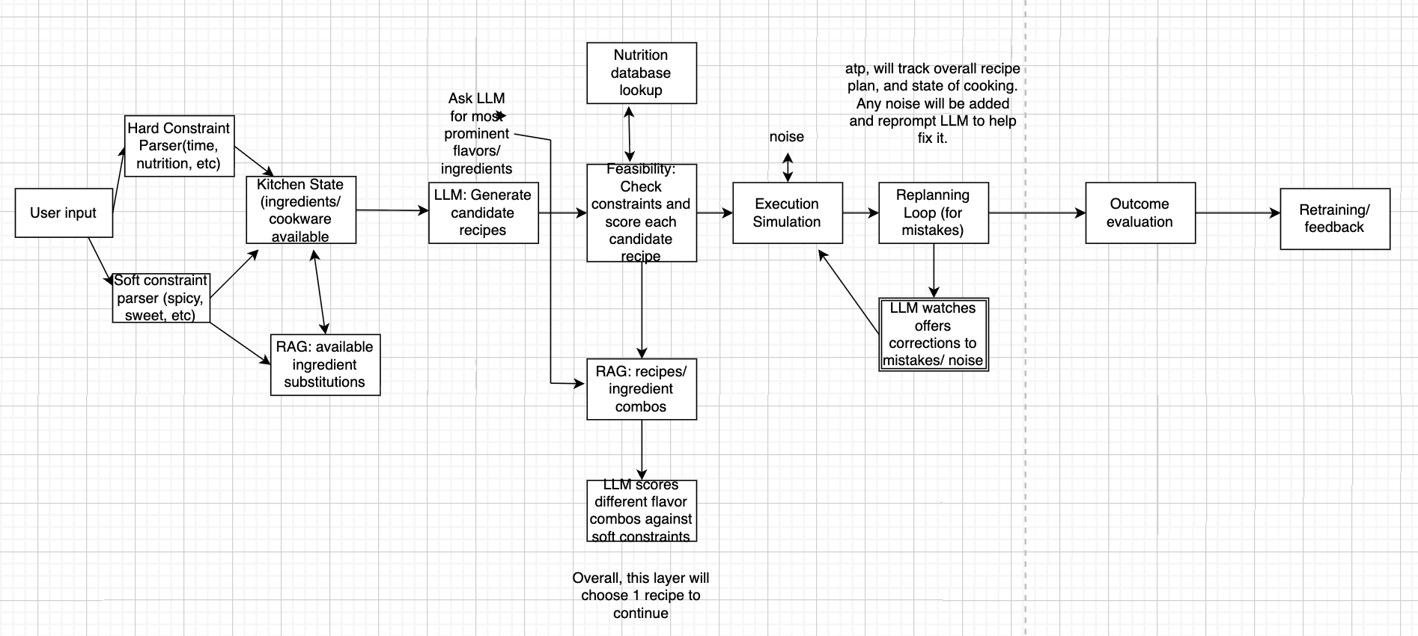
Updated Arch. Instead of ingredient substitutions, maybe have ingredient combinations that pair well go into LLM prompt?

